Slide 1
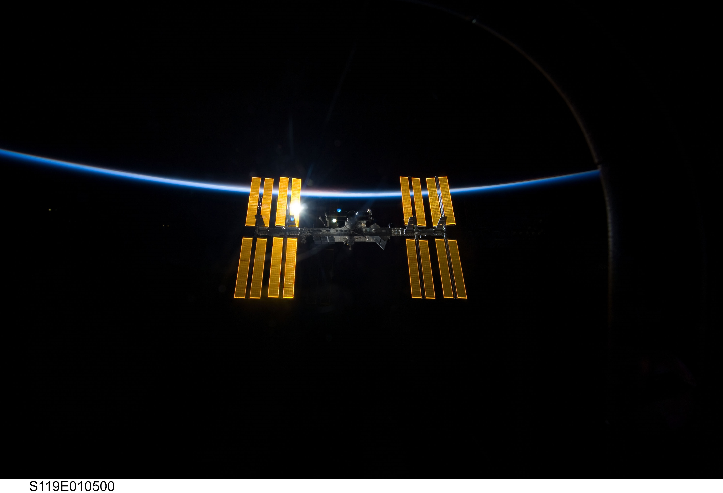

ISS Finder
SPOT THE STATION
Ivaylo Gergov
Tsvyatko Konov
Nikolay Vassilev

Slide 2
Problem – What’s the issue?
Many people do not know that they can observe the station
Many photographers need to know an accurate position for better photo taking
The station passes in less than 3 minutes, so you need to be prepared in time
Notes:
- many people that are already interested in this does can only track it though articles and images in the web.

Slide 3
Our solution – What we did?
Mobile application that uses augmented reality to display the station in the star map
Uses The Yale Bright Star Catalog to display accurate night sky
Notifications for upcoming passes
Information regarding brightness raise and set positions
Show the users in simple way how to find and observe the station

Slide 4
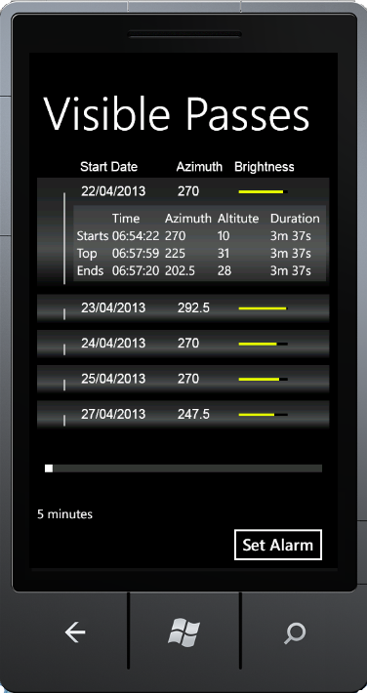
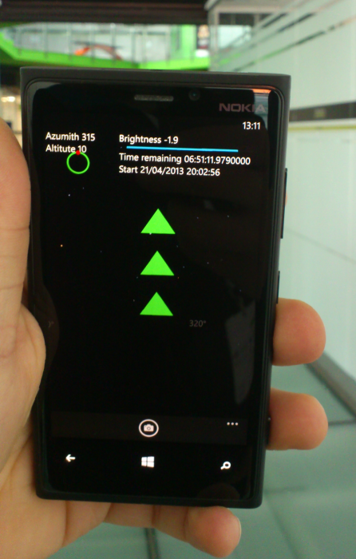
Our solution – What were our difficulties?
Challanges
New to XNA and Windows Phone
Started from scratch
Not trivial calculations for
coordinates

Slide 5
Our solution – what now?
Create in-app camera shot option to take pictures
RSS feeds for NASA Education news, NASA Breaking News
Social networks integration (share photos taken, experiences )
Include other significant objects that can be observed (satellites, stars, planets etc.) and info regarding them
Port the app to Windows8, Android, iPhone

Slide 6
Collaboration
Other team with the same challenge topic
Different technologies targeted
Helped each other and propose ideas

Slide 7
Resources
Video of the app - http://www.youtube.com/watch?v=86OYSvpW9XQ
Source code – https://github.com/TKonov/NasaChallenge

Slide 8
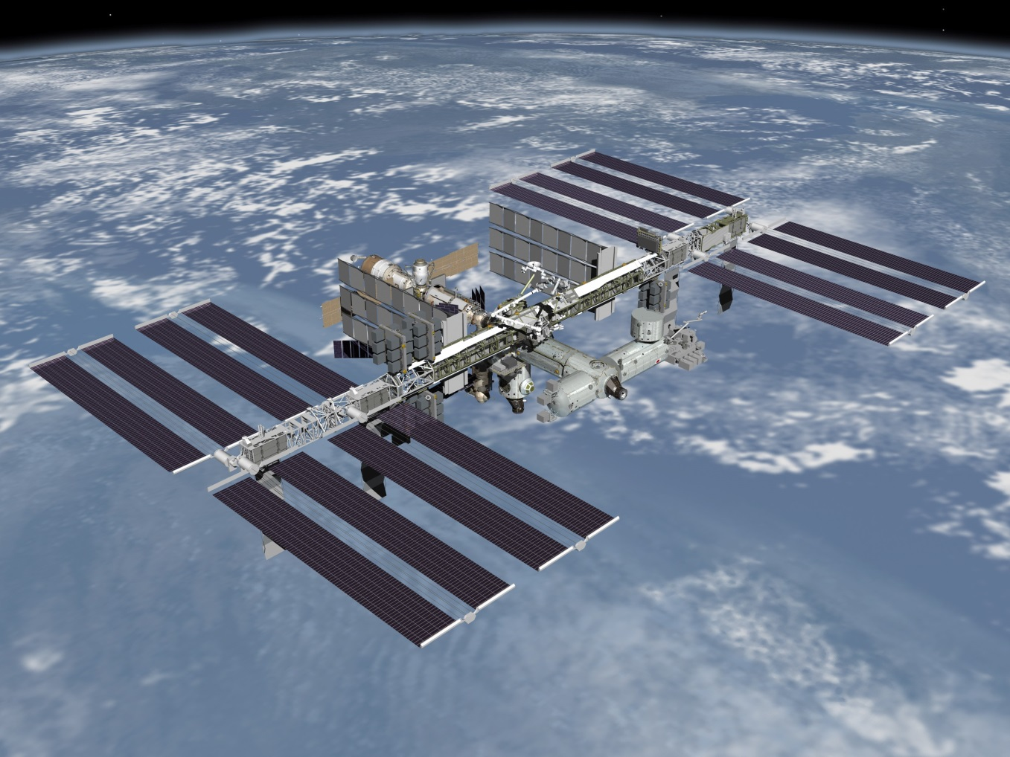
Ask us anything

